Slide 1
TF-IDF Assignment
Understanding and Implementing TF-IDF

Slide 2

Goal
To compute Term Frequency-Inverse Document Frequency (TF-IDF) for efficient document retrieval.
Enhance understanding of core concepts in Information Retrieval.

Slide 3

Objective
Implement a Python-based TF-IDF calculator.
1
Handle user queries effectively with error tolerance.
2
Provide accurate document rankings based on query relevance.
3

Slide 4
Installation Guide
1. Clone the repository
2. Create a virtual environment and install dependencies
3. Run the server using:
python manage.py runserver

Slide 5
Technologies Used
Python, Django
Core Data Structures (Dictionaries, Lists)
Algorithm Design (Custom TF-IDF Logic)

Slide 6
Core Features
1. File uploading and indexing
2. Keyword-based search with ranking
3. Stop word removal for efficient indexing

Slide 7
Code Explanation
1. TF-IDF model for indexing and ranking
2. Keyword matching for search results
3. Cosine similarity for ranking documents

Slide 8
Process
Preprocess Documents: Tokenize, clean, and prepare data.
Calculate TF-IDF: Compute term frequencies and inverse document frequencies.
Handle Queries: Match user inputs with calculated scores.
Rank Results: Provide documents ranked by relevance.

Slide 9
Understanding TF-IDF
Term Frequency (TF): Measures how often a term appears in a document.
Inverse Document Frequency (IDF): Reduces importance of commonly used terms.
TF-IDF Score: Combines TF and IDF to measure relevance.

Slide 10
Implementation Details
Input: A dictionary of documents and user queries.
Error Handling: Accounts for minor spelling mistakes in queries.
TF-IDF Calculation: Uses precise mathematical formulas.

Slide 11
Results and Insights
Ranked documents accurately based on query relevance.
Successfully handled noisy queries with error tolerance.
Insights into document structure and term importance.

Slide 12
Challenges
Handling spelling errors and variations in queries.
Designing an efficient TF-IDF computation model.
Managing large-scale document data.

Slide 13
Conclusion
TF-IDF is a powerful tool for information retrieval.
Implementation showcases practical application in document ranking.
Enhances understanding of core concepts in retrieval systems.

Slide 14
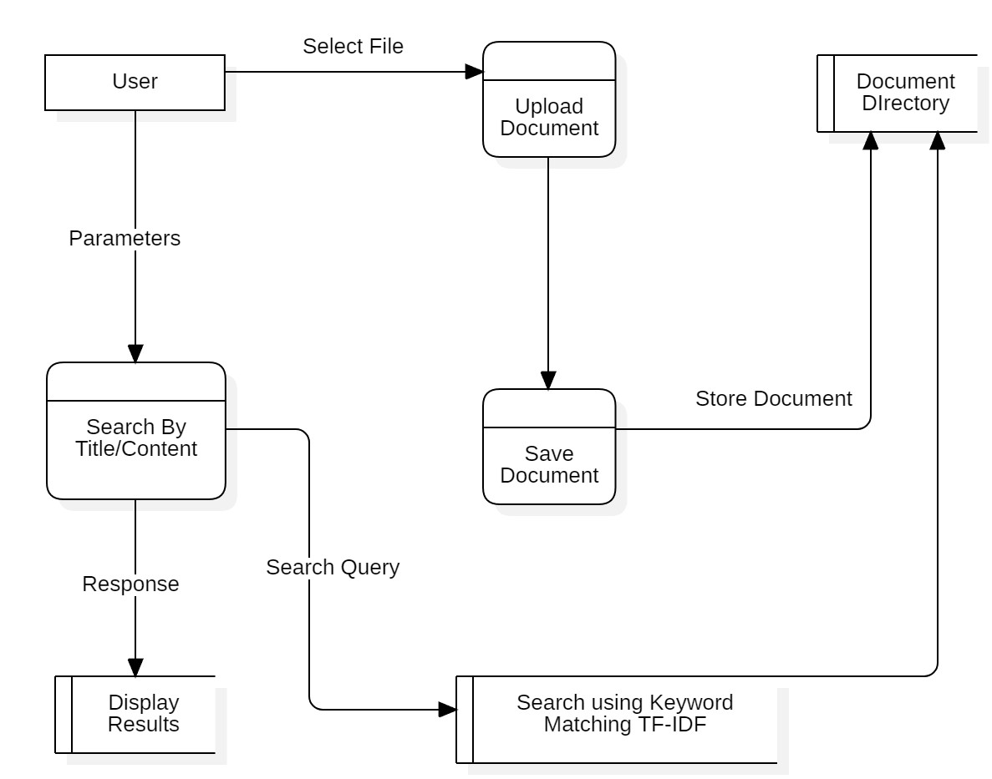
DFD

Slide 15
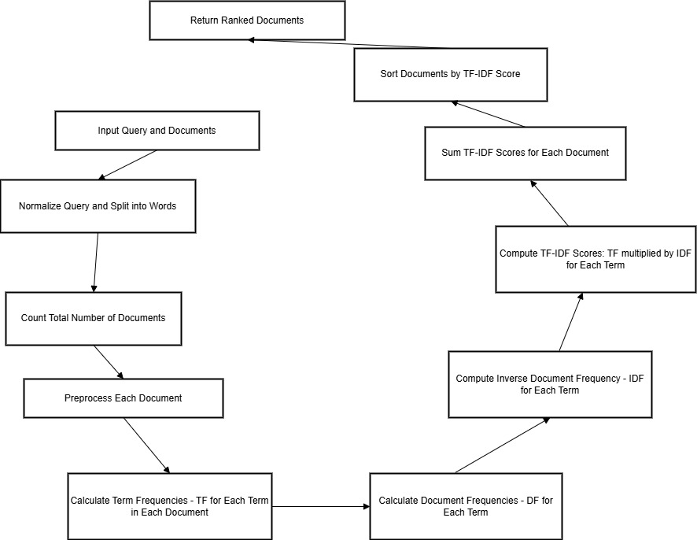
TF-IDF:

Slide 16
DFD Explanation
Upload Document: Stores files in the Document Directory.
Search By Title/Content: Locates documents based on search queries.
TF-IDF Ranking: Ensures accurate search results.
Display Results: Shows ranked search results.

Slide 17
Future Enhancements
Add support for multiple document formats (PDF, Word, etc.)
Integrate NLP and semantic search capabilities
Optimize search algorithms for better accuracy

Slide 18
Thank You
Questions and Discussions Welcome!

